Slide 1
Team 11 – Loss Hunters
Seek, Detect, Recover.

Slide 2
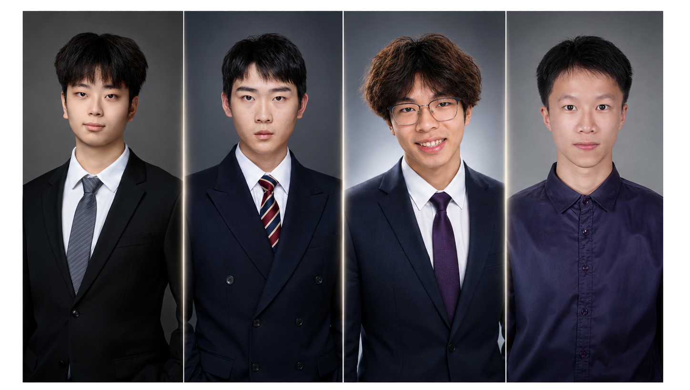

Team Members

Slide 3
Our Aims
In this program, we hope to understand how robotics, deep learning, and tele-operation can work together in a real-world system. We aim to build a robot that can perceive its environment, recognize target objects, and support remote human control. Through this project, we want to improve our skills in hardware integration, computer vision, system design, and teamwork.

Slide 4
Baseline Model Specification
Visual Perception Detect small objects and determine whether the user is watching. Solution: use object detection and face/head-pose recognition.
Precise Interaction Move or hide objects safely without falling from the desk. Solution: use edge sensors, low-speed control, and a simple scoop or magnet.
System Integration Ensure reliable communication between Raspberry Pi and Arduino. Solution: use serial communication, feedback signals, and manual override.

Slide 5
Our COOL Idea - Overview
Our advanced model is an AI-powered lost item hunting robot. The robot uses a camera and deep learning object detection to identify target items such as keys, bottles, or bags. It can move around a room, search for objects, and report the detected location to the remote user. The user can also take over control through tele-operation when the robot faces complex situations.

Slide 6
Key Problems
Visual Perception Detect small objects and determine whether the user is watching. Solution: use object detection and face/head-pose recognition.
Precise Interaction Move or hide objects safely without falling from the desk. Solution: use edge sensors, low-speed control, and a simple scoop or magnet.
System Integration Ensure reliable communication between Raspberry Pi and Arduino. Solution: use serial communication, feedback signals, and manual override.

